Slide 1
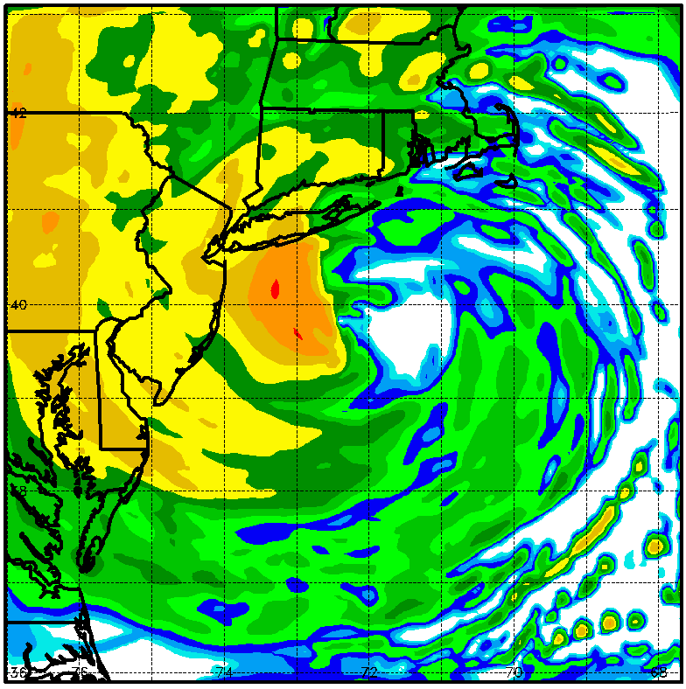
Application and Improvements to COAMPS-TC
Richard M. Hodur¹, J. Doyle², E. Hendricks², Y. Jin², J. Moskaitis², K. Sashegyi², J. Schmidt²
¹Innovative Employee Solutions/Science Applications International Corporation, Monterey, CA
²Naval Research Laboratory, Monterey, CA
2013 IHC/Tropical Cyclone Research Forum
College Park, MD
4-8 March 2013

Slide 2
Application and Improvements to COAMPS-TC
Outline
Current Methodology
  Synthetic Observations
  Real-Time Run Methodology
Proposed New Methodology
  New Synthetics
  Dynamic Initialization
Conclusion and Future Plans

Slide 3
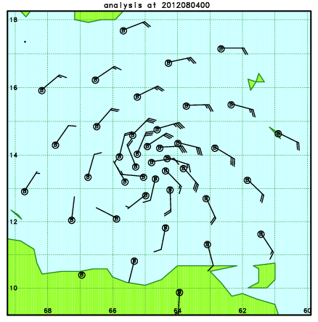
Synthetic TC Observations
Purpose
Create observations of the TC circulation, making up for the lack of real-time in-situ observations
Current Methodology
Fixed radii @ 0.5°, 1°, 2°, 3°, 4°, and 6°
8 profiles per radial ring
u-, v-, T, z values at each point
Modified Rankine vortex
9 levels from 1000 to 400 mb
Fixed vertical profile/No vertical tilt
Current storm motion included
Large-scale shear added
TC Synthetics for Ernesto 2012

Slide 4
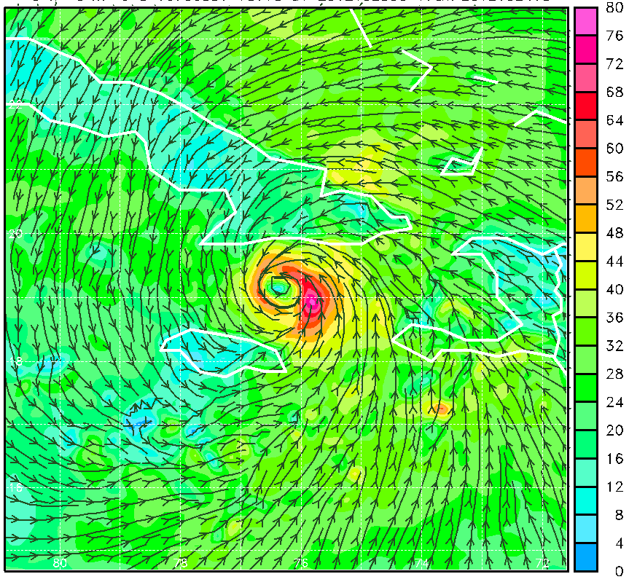
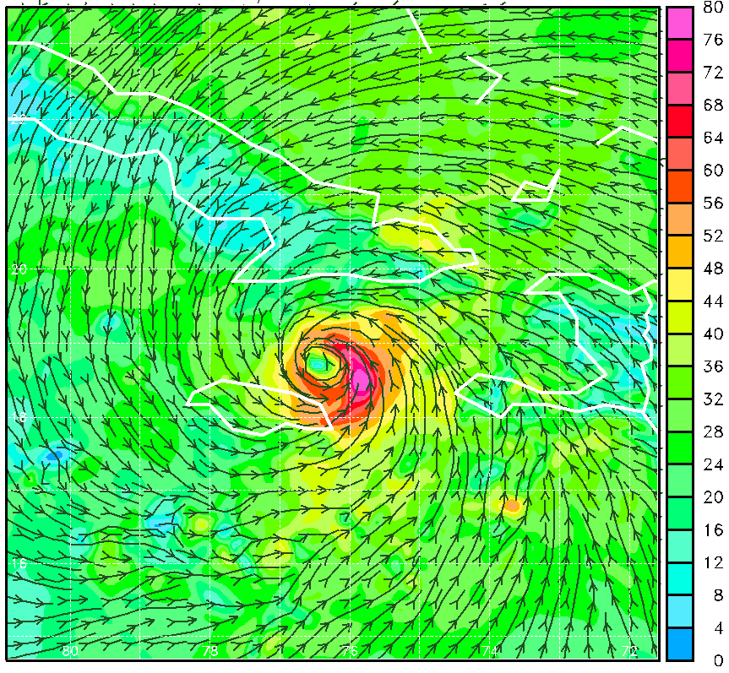
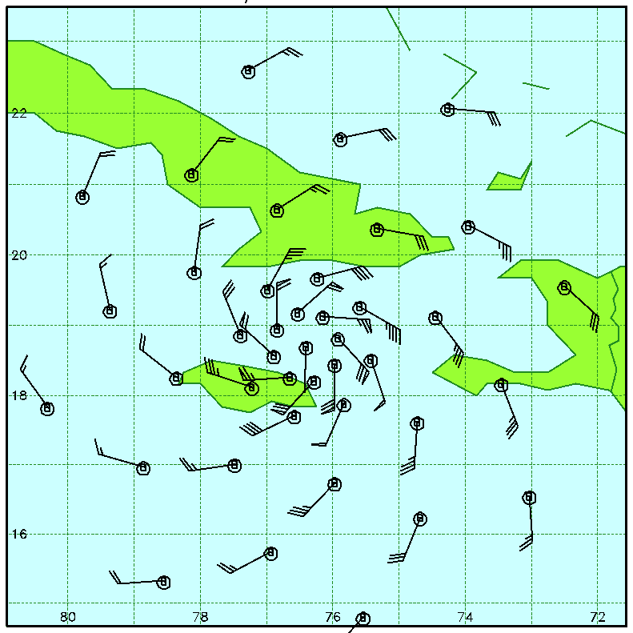
TC Analysis with NAVDAS
Sandy: 2012102500 Analysis
Relocate TC/Grid
Assimilate TC synthetics and all other real-time observations
First-Guess Field
Final Analysis
NAVDAS: NRL Atmospheric Variational Data Assimilation System

Slide 5
COAMPS Real-Time Run Methodology
Performed in 2008-2009 @ AF DSRC, 2010-2013 @ Navy DSRC
Cold Start
Global Analyses
Observations and TC Synthetics are used together in NAVDAS to generate the initial fields for the model
NAVDAS
Observations
TC Synthetics
Warm Start
6-h Forecast Fields
120-h Forecast
A 2-d ocean SST analysis (NCODA) is used to produce the SST field that is held constant during each forecast
SST Analysis
Global Forecast Fields - LBC

Slide 6
COAMPS Real-Time Run Methodology
Performed in 2008-2009 @ AF DSRC, 2010-2013 @ Navy DSRC
Cold Start
Global Analyses
The first time the system is run for a TC, a cold start is done, so global fields are used for the first-guess fields and for the lateral boundary conditions
NAVDAS
Observations
TC Synthetics
120-h Forecast
SST Analysis
Global Forecast Fields - LBC

Slide 7
COAMPS Real-Time Run Methodology
Warm Start
After the first time that COAMPS-TC is run for a system, warm starts are done and the global model fields are used only to supply the lateral boundary conditions
NAVDAS
Observations
TC Synthetics
Warm Start
6-h Forecast Fields
120-h Forecast
SST Analysis
Global Forecast Fields - LBC

Slide 8
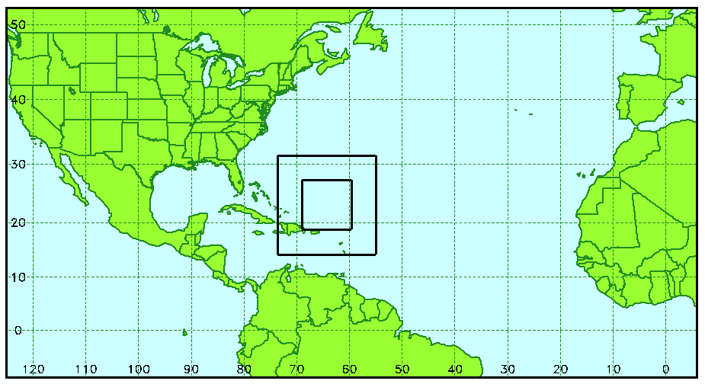
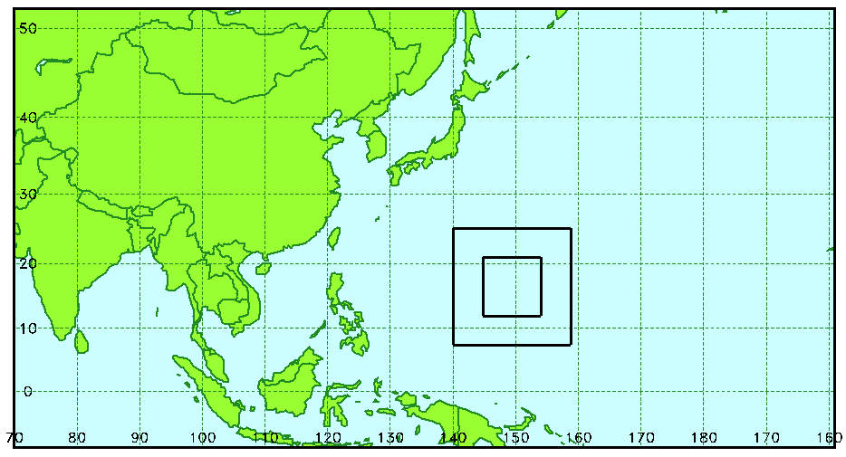
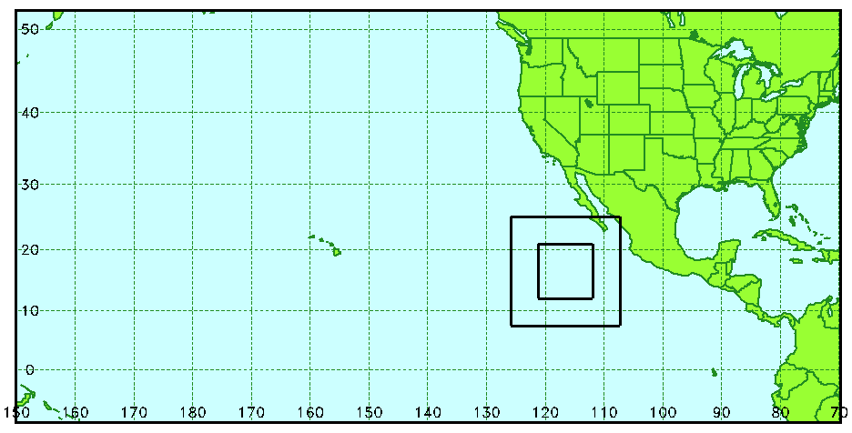
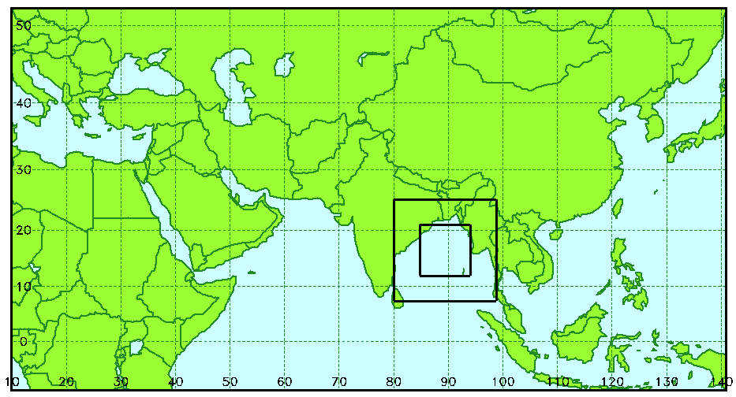
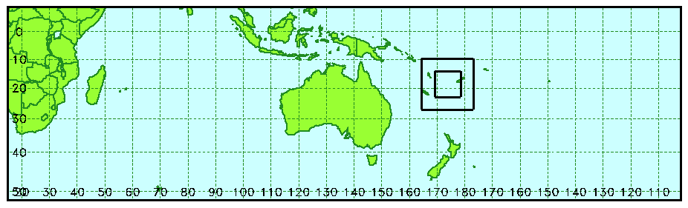
COAMPS-TC Areas
Western North Atlantic: 281x151
Western North Pacific: 281x151
Central and East North Pacific: 321x151
Arabian Sea and Bay of Bengal: 281x151
SW Pacific and South Indian Ocean: 521x151
Triple nested grids: 45/15/5 km
Inner grids:
  Move with the TC
  121x121 (15 km), 181x181 (5 km)
Multiple storms in any basin are run separately

Slide 9
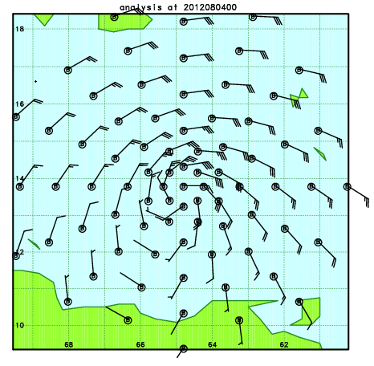
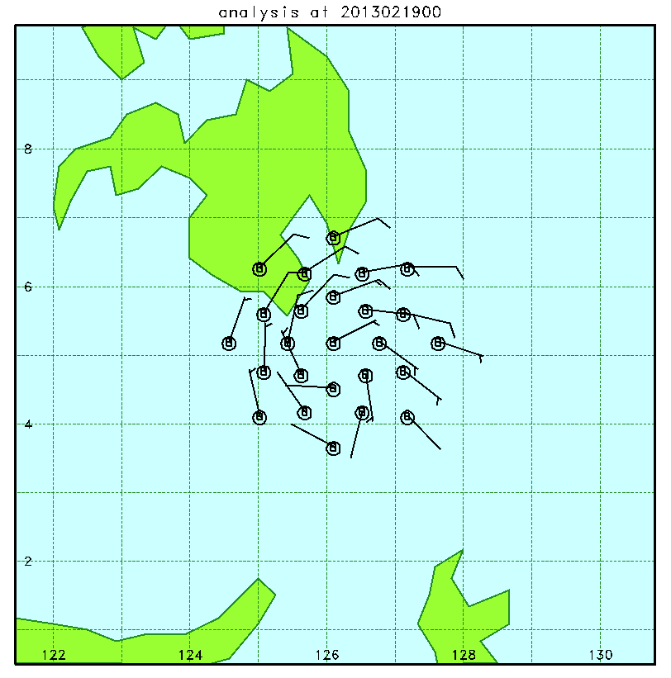
Synthetic TC Observations: New
Purpose
Create a new set of observations of the TC circulation that can be adapted for different sized storms
Proposed New Methodology
Variable positioning of the radial rings:
  One ring for the RMW (observed or first-guess)
  User-defined density (# of rings, # of synthetics per ring, and ring spacing)
  User-defined radii of outer-ring
Any number of profiles per radial ring
u-, v-, T, z values
Modified Rankine vortex
7 levels from 1000 to 400 mb
Fixed vertical profile/No vertical tilt
Current storm motion included
Large-scale shear added
TC Synthetics for Ernesto 05L/2012
TC Synthetics for invest area 98W/2013

Slide 10
Pre-Retro Test Cases
99 Cases from 2010, 2011, and 2012

Slide 11
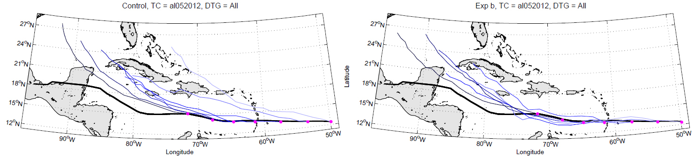
COAMPS-TC Track Forecasts
Old vs. New TC Synthetics
Ernesto (2012/05L)
Old Synthetics
New Synthetics
The new synthetics led to improved track forecasts for Ernesto, particularly in it’s early stages

Slide 12
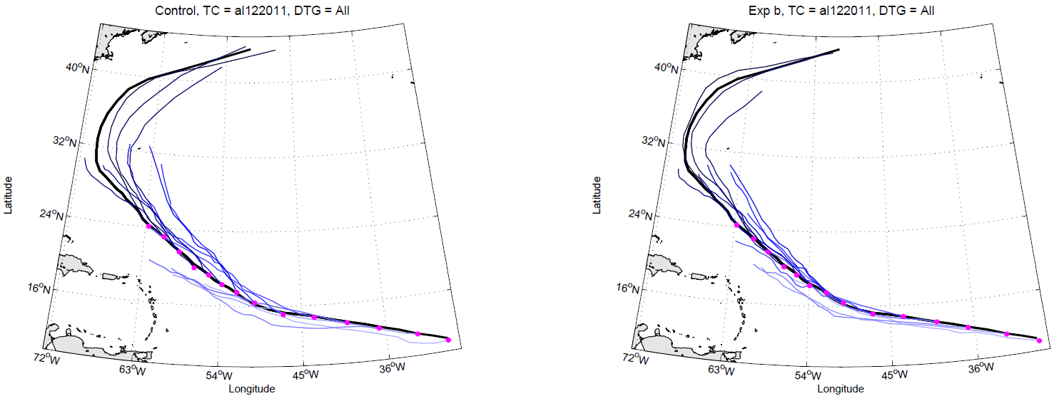
COAMPS-TC Track Forecasts
Old vs. New TC Synthetics
Katia (2011/12L)
Old Synthetics
New Synthetics
The new synthetics led to improved track forecasts for Katia, particularly during recurvature

Slide 13
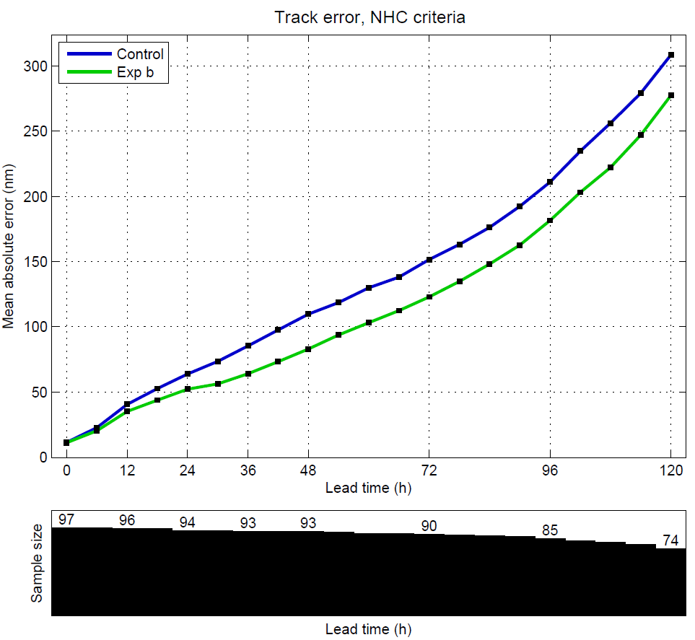
Effect of Synthetic Observations on COAMPS-TC Track Forecast Errors
Old (‘control’, blue) vs. New (‘b’, green) TC Synthetics
The average track error over all storms was lower using the new synthetics for all forecast times.

Slide 14
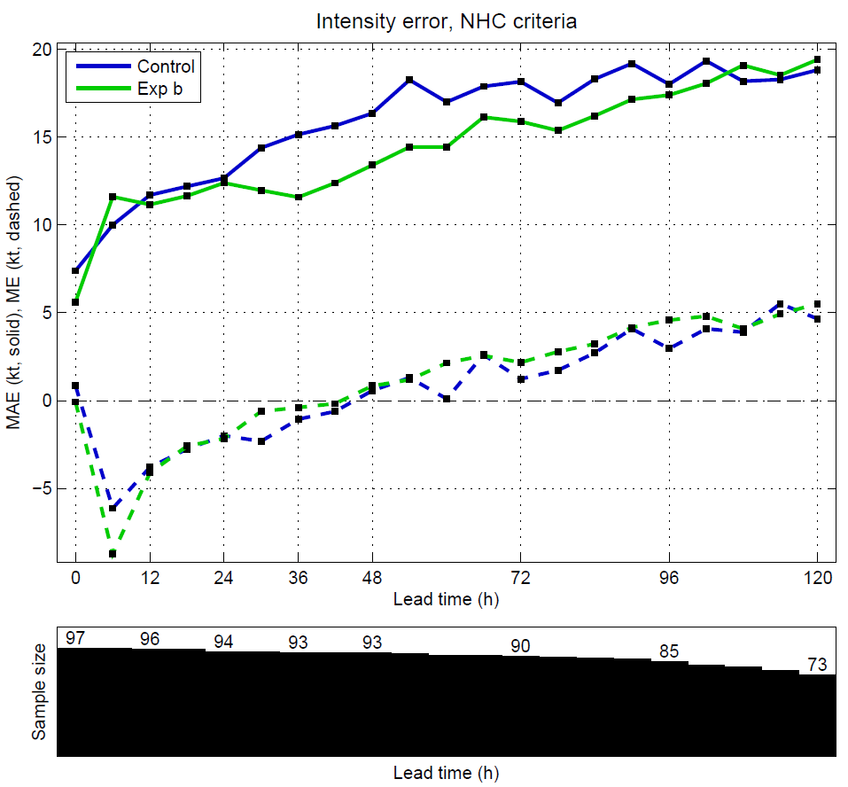
Effect of Synthetic Observations on COAMPS-TC Intensity Forecast Errors
Old (‘control’, blue) vs. New (‘b’, green) TC Synthetics
The average intensity error over all storms was lower using the new synthetics during the 30-102 h time period.
Initial “spin-down”

Slide 15
COAMPS Real-Time Run Methodology
Performed in 2008-2009 @ AF DSRC, 2010-2013 @ Navy DSRC
Cold Start
Global Analyses
Reminder
This is the method that is currently used for running COAMPS-TC
NAVDAS
Observations
TC Synthetics
Warm Start
6-h Forecast Fields
120-h Forecast
SST Analysis
Global Forecast Fields - LBC

Slide 16


COAMPS Proposed Run Methodology
TCDI/DI: Tropical Cyclone Dynamic Initialization/Dynamic Initialization
Hendricks et al. (2011) WAF, Zhang et al. (2012) WAF, Hendricks et al. (2013) MWR, submitted
Cold Start
Global Analyses
NAVDAS
Observations
Warm Start
6-h Forecast Fields
Remove TC Vortex
TCDI
120-h Forecast
Insert TC Vortex
12-h DI Forecast
DI
$\frac{∂u}{∂t}=−α(u−u_{a}$)
SST Analysis
Global Forecast Fields - LBC

Slide 17
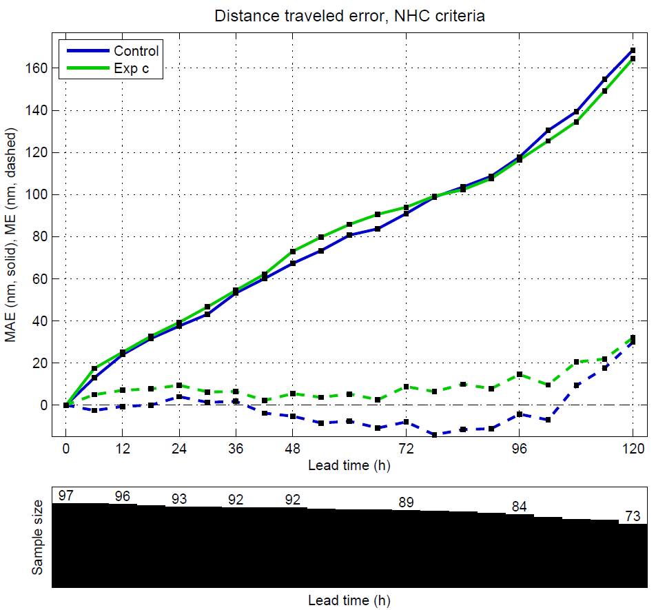
Effect of TCDI/DI on COAMPS-TC Track Forecast Errors
Old (‘control’, blue) vs. TCDI/DI (‘c’, green)
The average track error over all storms was unchanged using the TCDI/DI methodology for all forecast times.

Slide 18
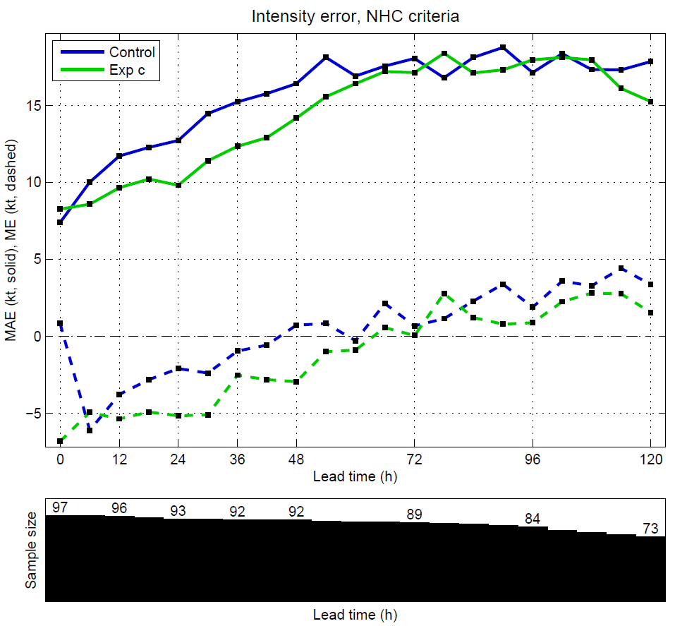
Effect of TCDI/DI on COAMPS-TC Intensity Forecast Errors
Old (‘control’, blue) vs. TCDI/DI (‘c’, green)
The average intensity error over all storms was lower using TCDI/DI during the 6-54 h time period.
Also, the initial spin-down was eliminated.

Slide 19

COAMPS Proposed Run Methodology
NS/DI: New Synthetics/Dynamic Initialization
Cold Start
Global Analyses
NAVDAS
Observations
New TC Synthetics
12-h DI Forecast
$\frac{∂u}{∂t}=−α(u−u_{a}$)
Warm Start
6-h Forecast Fields
120-h Forecast
SST Analysis
Global Forecast Fields - LBC

Slide 20
Conclusion and Future Plans
COAMPS-TC
Real-time applications (2008-2012)
New synthetics:
    Improved track forecasts
    Improved intensity forecasts
TCDI/DI:
    No change to track forecasts
    Improved intensity forecasts
    Eliminates initial spin-down
Next steps:
    New synthetics
    DI
    2013 retro cases and real-time forecasts

Slide 21
Application and Improvements to COAMPS-TC
Richard M. Hodur¹, J. Doyle², E. Hendricks², Y. Jin², J. Moskaitis², K. Sashegyi², J. Schmidt²
¹Innovative Employee Solutions/Science Applications International Corporation, Monterey, CA
²Naval Research Laboratory, Monterey, CA
2013 IHC/Tropical Cyclone Research Forum
College Park, MD
4-8 March 2013

